Slide 1
Conform or Transform
Session 32 of ?
MEN to MEN
A Bible Study about a letter written to the Church in Rome
Romans 12:1,2
BECAUSE HE GAVE HIS LIFE FOR YOU IN DEATH, SO GIVE YOUR LIFE FOR HIM IN LIFE.
Notes:
It has been said:
If a man eating lion was loose in America
This veracious being would slowly die of starvation.
For the lack of men
Men willing to stand up and be men
Men willing to take their place in the world they live
Men willing not to conform to the current culture
Men willing to conform to this world
to an image of unisexual blandness
to an image of being politically correct as not to offend,
So green minded that you feel bad using a fir 2x4 board to hold up a sagging wall
Men who run to find their safe space whe confronted by any disagreement.
Men who as so wish washy on any subject that they just blow away in any light breeze.
Men who think just getting along, is better than being seen as rebel
Men who wear the latest aftershave called Acquiescence
We need men who are compassionate in strength
We need men willing and able to love others with depth.
We need men who hug other men in efforts to share power of conviction
I have met a number of real men.
And it has nothing to do with age
I have met and worked along side of 16 year old men
I have men who have not shaved yet but were willing to stand out and step up.
I have also met men who are old and are not really men they are just boys.
We need a wake up call to become true men and know the will of God and do it no matter what may come.
We need men who are dependent upon God
We need men to are be what they are called to be.
We need men to be heads of household
We need men who are Jesus to their families.
We need men seeking to become the very image of God to the world.
Slide1
Men seem to have vacated their place
We have become like the abominable snowman. Lots of foot prints but nont to be found.
Our world around us we have become a generation of boys and their toys.
Raised to be men by their mothers.
40% of all white households have no father in the home
70% of all the black households are the same way
And those who remain seem to be unable or unwilling to take their God given place of leadership.

Slide 2
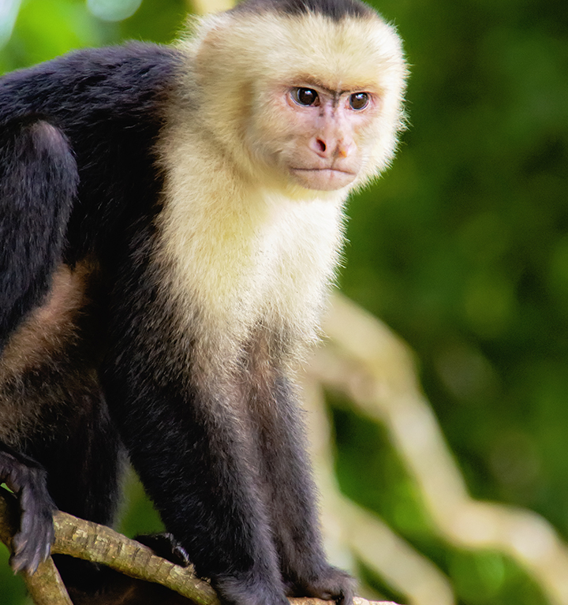
To catch a monkey
Notes:
2

Slide 3
We have come a long way my brothers.
Five groups in the Church in Rome
Five became two – branches and trees
Eleven Chapters
1,2,3 – We are under God’s wrath, but we were proclaimed righteous.
4 – We are justified freely by faith, just by believing in God like Abraham.
5 – We have access to God at all times, there is a hope in heaven and in our own trials and problems God is still alive and well and is helping.
6,7,8 – We are slaves freed from law, sin and adopted. He is living inside of us.
9,10,11 – Look at all the promises God has given to Israel and know He will always keep is promises.
What one important doctrine or idea have you learned from the first eleven chapters of Romans?

Slide 4
Three sections to our study tonight
An encouragement to give, present, provide, yield.
The method which we are transformed, not conformed
The understanding of what God really wants for us, the revelation of His Will

Slide 5
Romans 12:1,2
Therefore, I urge you, brethren, by the mercies of God, to present your bodies a living and holy sacrifice, acceptable to God, which is your spiritual service of worship. And do not be conformed to this world, but be transformed by the renewing of your mind, so that you may prove what the will of God is, that which is good and acceptable and perfect.
BECAUSE HE GAVE HIS LIFE FOR YOU IN DEATH, SO GIVE YOUR LIFE FOR HIM IN LIFE.
Notes:
Always ask what is the therefore, therefore?
Accordingly
Always points backwards to what has already been known
It is assumed that what went before is true and accepted
Paul is looking back at all that he had said before.
The unity of the faith in Jesus
Forgiveness offered freely
Proclamation of righteousness
Promises of Hope and relationship
Freedom from those things that hinder
Justification
Hope
Statements of promise.
Paul is taking all the previous eleven chapters and placing them before the Romans Church.
This is the stuff that makes you different.
No longer Jew and Gentile, but Christian.

Slide 6
Romans 12:1,2
Therefore, I urge you, brethren, by the mercies of God, to present your bodies a living and holy sacrifice, acceptable to God, which is your spiritual service of worship. And do not be conformed to this world, but be transformed by the renewing of your mind, so that you may prove what the will of God is, that which is good and acceptable and perfect.
BECAUSE HE GAVE HIS LIFE FOR YOU IN DEATH, SO GIVE YOUR LIFE FOR HIM IN LIFE.
Notes:
The first eleven chapters was about diversity within unity.
Plop down all the arguments that have divided you and gather in to one church.
BRETHREN
I ASK OF YOU TO LOOK AT YOURSELVES AS ONE.
I BEG OF YOU TO SEE WHAT YOU ARE AS UNITED
MY DESIRE IS FOR YOU TO SEE A SINGLE CHURCH.
I INVITE YOU TO GIVE UP ALL THE FACTIONS AND SEE THE AGREEMENT ON THESE THINGS
I PLEAD OF YOU TO SEE YOURSELVES AS MORE THAN YOU AND THEM AND SEE YOURSELVES AS BRETHREN
You are special. We are held to a higher standard.
Reminder…….
We can not expect unbelievers to live the same way we do.
Sinners do what they do best: SIN.
That is what they are and they will stay that way until
they see something in us that is different from the world.
We can not expect the world to just give in to our way of living.
Romans 12:1,2 is only for Christians not for the world.
It is only for the church.
It is only for us in this room tonight.

Slide 7
Romans 12:1,2
Therefore, I urge you, brethren, by the mercies of God, to present your bodies a living and holy sacrifice, acceptable to God, which is your spiritual service of worship. And do not be conformed to this world, but be transformed by the renewing of your mind, so that you may prove what the will of God is, that which is good and acceptable and perfect.
BECAUSE HE GAVE HIS LIFE FOR YOU IN DEATH, SO GIVE YOUR LIFE FOR HIM IN LIFE.
Notes:
The reason for the encouragement to this urging.
The reason for the appeal is based upon specific truths.
BY THE MERCIES OF GOD
It is the long litany of what God has done we are encouraged to make a change.
It is based upon the eleven chapters understanding
God making man, knowing full well there was a possibility they would reject HIM
To take their own paths
Yet God never stopped offering great and tender mercy
God’s compassion, his MERCY is forever
God is still knocking
God is still offering
Even though Man is vile, terrible, rebellious and evil, God is still calling.
God’s pity motivates his grace
God’s love motivates his mercy.
MERCIES:
God has forgiven us
God has declared us righteous
God has made us His children
God has made great and precious promises.
All things work together for good for those who love God and are called to his purpose?
He did not spare His Son but delivered Him up for us, how much more will He give us all things?

Slide 8
Romans 12:1,2
Therefore, I urge you, brethren, by the mercies of God, to present your bodies a living and holy sacrifice, acceptable to God, which is your spiritual service of worship. And do not be conformed to this world, but be transformed by the renewing of your mind, so that you may prove what the will of God is, that which is good and acceptable and perfect.
BECAUSE HE GAVE HIS LIFE FOR YOU IN DEATH, SO GIVE YOUR LIFE FOR HIM IN LIFE.
Notes:
I urge
You Brethren
Because of the mercies given and displayed
IT IS YOUR TURN.
It is now your time to respond.
Without our response. We are like the monkey. Hand grasped to get and not letting go even if it threatens your very lives.
Without the presentation of our lives we are only greedy, lustful, wanting, getters.
If I am saved, it is something I have received.
If I am forgiven, it is something I have received.
If I am justified, it is something I have received.
If I am a child of God, it is something I have received.
If I have a new path, it is something I have received.
If I have a new inheritance, it is something I have received.
If I have Jesus in my heart, it is something I have received.
If I am unified with my brethren, it is something I have received.
If I now have a destiny, it is something I have received.
If I have a call to be more, it is something I have received.
If I am more, it is something I have received.
If I am a new creature, it is something I have received.
If you see your faith as only to provide you something you missed it.
If Christianity is just get it, got it, and done you missed the greatest mercy of all.
The knowing of God’s will for you individually. A will that is good acceptable and perfect.
The reciprocity of all that you have received is to first give up your life.

Slide 9
Three sections to our study tonight
An encouragement to give, present, provide, yield.
The method which we are transformed, not conformed
The understanding of what God really wants for us, the revelation of His Will

Slide 10
Romans 12:1,2
Therefore, I urge you, brethren, by the mercies of God, to present your bodies a living and holy sacrifice, acceptable to God, which is your spiritual service of worship. And do not be conformed to this world, but be transformed by the renewing of your mind, so that you may prove what the will of God is, that which is good and acceptable and perfect.
BECAUSE HE GAVE HIS LIFE FOR YOU IN DEATH, SO GIVE YOUR LIFE FOR HIM IN LIFE.
Notes:
Living sacrifice. It is not just saved, sanctified and then Petrified.
Holy Sacrifice. It is not salvation. You are forgiven, you are justified, you are set apart. You are proclaimed righteous. You are holy.. Without holiness no man will see God.
Without holiness there is no sacrifice
All the singing, all the standing and sitting, all the mercies given mean nothing without this idea of holiness.
Holiness is the requirement for what we do.
A holy and living sacrafice is the only type which is acceptable.
All else does not matter
All the effort does not matter
All the bible studies do not matter
All the prayers around the table at dinner do not matter.
What we are and what we sacrifice is the measure of the acceptability.
Here Lord take it.
It is no longer mine
I no longer care what the world has to offer.
If my deteriorates to the point of uselessness. It really doesen’t matter it is yours.
I am not just a getter
I am not just sucking at the nipple of God to get my sustenance.

Slide 11
Romans 12:1,2
Therefore, I urge you, brethren, by the mercies of God, to present your bodies a living and holy sacrifice, acceptable to God, which is your spiritual service of worship. And do not be conformed to this world, but be transformed by the renewing of your mind, so that you may prove what the will of God is, that which is good and acceptable and perfect.
BECAUSE HE GAVE HIS LIFE FOR YOU IN DEATH, SO GIVE YOUR LIFE FOR HIM IN LIFE.
Notes:
This holy and acceptable sacrifice to God is placed into context
There are boundaries in what God is due.
Paul is saying that with the body there must also be the connection to the spirit.
IT is SPIRITUAL SERVICE OF WORSHIP.
The word here is difficult at best.
I learned this scripture early in my walk with God.
I learned it as REASONABLE service. KJV
It means more than that.
It is me ministering back to God.
It is service rendered for payment already made.
It is doing that which is reasonable to the payer.
It is following the requirements to perform sacred services to God
Newer translations have it as spiritual service of worship.
But the issue is that this becomes something we do only in church.
And in church it is only the singing.
WHEN DID WORSHIP BECOME ONLY SINGING? For another day.
Spiritual Service of Worship.

Slide 12
Romans 12:1,2
Therefore, I urge you, brethren, by the mercies of God, to present your bodies a living and holy sacrifice, acceptable to God, which is your spiritual service of worship. And do not be conformed to this world, but be transformed by the renewing of your mind, so that you may prove what the will of God is, that which is good and acceptable and perfect.
BECAUSE HE GAVE HIS LIFE FOR YOU IN DEATH, SO GIVE YOUR LIFE FOR HIM IN LIFE.
Notes:
So how do we get there.
How can I know what is reasonable, or spiritual or holy
That I may be the holy and living sacrifice
In response to the mercies of God already provided?
You can’t
As long as you are conformed to this world.
As long as you set the measuring stick of life by what others think.
Why do we conform? Why do we want to be part of a group?
There is more in the context of conformity in the guide. Can’t go through it tonight.
Again there is a requirement, a spiritual requirement, a holy requirement, an acceptable requirement, a sacrificial requirement, a spiritual requirement, a worshipful requirement.
AND IT IS NOT TO CONFORM TO THIS WORLD.
The requirement is to be transformed. Massively, totally, spiritually, acceptably, sacrificially, and absolutely.
Bodies presented
Spirit focused
Total Self changing
BY THE TRANSFORMATION OF YOUR MIND.
The mind is equated as the decision maker.
It receives input from the body and the spirit
And makes the decisions of life with the input.
IF YOU HAVE SACRIFICED THE BODY
IF YOU ARE SPIRITUALLY POINTED TOWARD SERVICE
THEN THE MIND IS RENEWED, TRANSFORMED.

Slide 13
Three sections to our study tonight
An encouragement to give, present, provide, yield.
The method which we are transformed, not conformed
The understanding of what God really wants for us, the revelation of His Will

Slide 14
Romans 12:1,2
Therefore, I urge you, brethren, by the mercies of God, to present your bodies a living and holy sacrifice, acceptable to God, which is your spiritual service of worship. And do not be conformed to this world, but be transformed by the renewing of your mind, so that you may prove what the will of God is, that which is good and acceptable and perfect.
BECAUSE HE GAVE HIS LIFE FOR YOU IN DEATH, SO GIVE YOUR LIFE FOR HIM IN LIFE.
Notes:
Once the mind is renewed
Then and then will you be able to understand what God wants from you in every decision you make.
You can look at any situation and Prove…..
Prove dokimázō
to test, examine, prove, scrutinize (to see whether a thing is genuine or not), as metals;
to recognize as genuine after examination, to approve, deem worthy

Slide 15
Romans 12:1,2
Therefore, I urge you, brethren, by the mercies of God, to present your bodies a living and holy sacrifice, acceptable to God, which is your spiritual service of worship. And do not be conformed to this world, but be transformed by the renewing of your mind, so that you may prove what the will of God is, that which is good and acceptable and perfect.
BECAUSE HE GAVE HIS LIFE FOR YOU IN DEATH, SO GIVE YOUR LIFE FOR HIM IN LIFE.
Notes:
And one you have proved it by the sacrificed body, and the rule of the spirit, and the transformed mind we will be able to prove, with certainty what the will of God is.
AND IT IS GOOD AND ACCEPTABLE AND PERFECT.
GOOD BECAUSE IT FEELS RIGHT WITH THE WHOLE OF YOUR BEING ANTROPOS.
ACCEPTABLE BECAUSE WE KNOW WE ARE EXACTLY WHERE GOD WANTS US TO BE.
PERFECT BECAUSE IT IS GOD MADE, MATURE AND FINISHED
It starts with the body. As a living sacrifice
Then to the spirit. Life as a continuing act of worship.
Then the Mind in making the decisions God wants.
When all are in synch it will be
good, acceptable, and perfect.

Slide 16
What is Romans 12:1,2 main idea?
Yes, it is about the life of the church
Yes, it is about God’s mercy
Yes, it is about God wanting us to be more
Yes, it is about the triune nature of Man
Yes, it is about a change of life from conformity to transforming
But the greatest idea we can pull from this scripture is WE CAN KNOW.

