Slide 1
Romans 7:7-13
Men to Men Ministries
Session 18
Notes:
13 verses.
When in the design phase of this study, I originally thought we could sail right through Chapter 7 I one week.
Didn’t work out that way
First 13 verses is more of the progress toward how we shall then live.
About our union with Jesus and how that union directly changes us.
Three chapters of Pauls letter to the Roman church make up the heart of the Apostile out of time
Chapter 6 – He was justified. Counted as righteous. A label was put on his soul that he was saved by faith in the atoning work of Jesus
Chapter 7 – Paul’s personal struggle with the flesh. Justification was the beginning of his struggles.
Chapter 8 – Paul’s discovery of a source of victory from his struggle

Slide 2
Parable of Grass
This Photo by Unknown Author is licensed under CC BY-NC-ND
Notes:
I have owned at least twenty lawn mowers in my epic war on grass through the years.
I had a push mower that never seemed to cut well because it was not sharp and I really did not know how to sharpen a spiral shaped blade inherent with that type of machine.
One mower was left in the garage of a house I bought in Colorado, the former owners did not think it worth taking it with them and refused to start unless I sprayed the carburetor with very flammable spray from a pressurized can.
I possessed a mower that I ran by using denatured alcohol.
Some of my war tools had pull starters, some had electric starters.
One was self-propelled.
I have permanently loaned two of my latest weapons of grass destruction to my son.
I had one that smoked so badly that the EPA could well classify it as a gross polluter.
Each one of these highly engineered inventions of the human mind was designed to cut the overgrowth of grass down to a perfect two and one-half inches.
These tools were instrumental in reaching my goal of lawn perfection.
Each of these spinning contraptions were possessed to create something else; the perfect lawn.
You have seen those lawns.
Not a blade of grass out of place.
The uniformity of the turf could well be described as a carpet of luxury.
Oh, how I struggled week after week to keep that perfect green expanse.
I would mow, trim, blow, rake, fertilize, water and worry over that patch of green.
I WAS UNDER THE LAW OF GREEN PERFECTION.
Never-the-less, the next day, no matter how good the mower was and no matter how contentiously the lawn was edged, there would be little blades out of place.
Perfection lost.
There was just no end to the effort to attain perfection.
What is even worse was the neighbor across the street never watered his front yard and died.
It was a warning to me if I ever slacked in my efforts, I too could be one of those who just let things go.
The typical keeper of the LAW OF THE LAWN has many choices:
Let it grow until the city comes by and posts a nice compliance note,
stop watering and let it all die all in the name of water conservation,
or hire someone to do it for you.
My decision was to let someone else do it for me.
My daughter now comes by everyother week and pushes my electric mower.
I feel both grateful and ashamed.
No more fighting the battle of the lawn.
It looks a little ragged by the second week but I have learned that there is a peace in letting someone else take responsibility for my lawn.
I can simply give up and give it to someone else.
There is a parable in this missive.
Sometimes, if not all the time, we need to just give up and let God do what he does best.
God doing the lawn work of my life.
If a little blade seems to be out of place, then my responsibility is to let go and realize that its God’s lawn.
His response maybe to instruct me to do something about the errant grass,
His response may well to let him handle it,
or He may provide a new tool to do the work.
But I have given my personal life to God.
But the most important and most gratifying part of giving my life to God (including my lawn) is that He gives peace.
Peace is a gift from God.
We do not make peace with God.
We receive peace as a boon when we come to a penitent trust in Him.
He is my peace.

Slide 3
Romans 7:7-12
7 What shall we say then? Is the Law sin? May it never be! On the contrary, I would not have come to know sin except through the Law; for I would not have known about coveting if the Law had not said, "YOU SHALL NOT COVET."
8 But sin, taking opportunity through the commandment, produced in me coveting of every kind; for apart from the Law sin is dead.
9 I was once alive apart from the Law; but when the commandment came, sin became alive and I died;
10 and this commandment, which was to result in life, proved to result in death for me;
11 for sin, taking an opportunity through the commandment, deceived me and through it killed me.
12 So then, the Law is holy, and the commandment is holy and righteous and good.
Notes:
This section of Paul’s writing to the Roman church is very personal
INCLUSIONARY.
HE IS A PART AND EXAMPLE OF THE WHOLE JEWISH POPULATION.
(SIDE NOTE) 5 GROUPS – THE JEWS WERE THE MOST PROBLEMATIC____
First he tries to relate to the readers in V 7. WE
Who is we?
Does the inclusion within a group lessen the injury.
President Biden
Hawaii fire – to try to relate tells of a kitchen fire that if not detected and put out in time
Lost one of his six houses
Could have lost is precious Corvette
Could have burned up cases of Presidential Papers.
Probably not a good example to those how had lost everything.
Who is we?.........................................
Last week began the 7th chapter
V 4 You were created to die
You jointed
WE are to bear fruit
V5 We are in the flesh
Our bodies
V6 We released
We were bound
We serve
---------------------------------
V7 We say
Change of voice
I would have come to know
I would not know coveting
V8 Produced in me
V9 I was once alive
I died
V10 Death for me
V11 Decieved me
Killed me
V12 Though it does not say it, it is inferred “So then, the law is holy, and the commandment is holy and righteous and Good (TO ME)

Slide 4
IS THE LAW SIN?
What shall we say then?
Is the Law sin?
May it never be!
On the contrary,
I would not have come to know sin except through the Law;
for I would not have known about coveting if the Law had not said, "YOU SHALL NOT COVET."
Notes:
Jewish anger…
Held the law as the manifested God in their lives.
It set the jurisdiction of their uniqueness. It set them apart.
Romans 3:7 My truth is God’s GLORY. ---- so why am I still counted as a sinner.
If the law revealed to the Jewish people is the unique identier of our being chosen out of the entire world
Then way am I counted with the rest of the world as sinners.
VERY IMPORTANT HERE
up to this point every I, we, brethren, was used as an inclusionary example of the total.
JEWISH THOUGHT
The law is good
There is value in the law
It has its place
BUT ONLY AS A VEHICLE OF GOD’S WILL NOT GOD HIMSELF.
JEWISH REACTION:
HOLD IT PAUL
“Do you lesson the worth of the law to only a pointer?
“are you saying that the purpose of the law is the encouragement of sin?
“Are you saying the law causes us to sin?”

Slide 5
Absolutely NOT!
Every American knows there are government expenses that are absolutely not necessary. It is impossible that every one of the 2.4 trillion dollars is being spent in the most efficient and necessary manner.
Notes:
We all use idioms.
Little phrases that we use
To start a new thought
To respond to a question
It could be a thought stopper
It could be transition from one idea to the next.
“Let me think about that”
“I get a kick out of it”
“Piece of cake”
“Pig out”
--
Hell no
When pigs fly
For Paul -“May it never be”
By no means
Never was
Never will be
Can’t happen
When pigs fly
Absolutely never have been or ever will be.
impossible
Absolute denial
Won’t happen on my watch
Very adamant to the impossibility
Out of your mind to think that way
3:4
3:6
3:31
6:2
6:15
7:7
7:13
(:14
11:1
11:11
I cor 6:15
Galatians 2:17
3:2
6:14

Slide 6
Romans 7:7-12
How do we know we are justified before Christ?
WDJD (What did Jesus do?” - JUSTIFIES
WWJD (what would Jesus do?) - LAW
WWJW (what would Jesus want?) - FRUIT
Notes:
WHY has he saved us?
Looks like we are to do one of two things.
Fruit for God
Fruit for death (law)
READ Romans 7:4 bear fruit for God, not fruit that perishes, embarrassed about, but fruit that is good and pleasing to God.
Speaks to our motives.
We can determine our justification, our life with Christ by our intent of keeping the law to please God, to earn his favor.
OR
We can determine our justification, our life with Christ our production of fruit
LAW negative…. NOT TO DO
Fruit Positive …. What I do.
FRUIT
Buy what we produce. Our actions will tell of our current state with God.
Not that we will ever be justified by them
Not that we will ever be counted as righteousness by them.
Not that our works will earn us salvation.
In the law we used to keep a code of rules to try to gain God’s approval,
NOW that we have experienced His love, assured of His acceptance of us in Christ, we want to thank Him, show Him our love, “walk in newness of life”
Romans 6:4 and serve God in the “new way of the Spirit”
Romans 7:6. Have you ever really stopped and thought about your motivations?
It is a brain change. It has to do with motives……..
Why you do the things you do?
Why are you here?
to make you feel better about yourself? Fruit for death.
To get Larry off your back? Fruit of death
There is no better things on TV tonight? Fruit of death
But if you are here to lift each other’s burdens in prayer? Fruit of God
If you are here to discover what God wants in your life? Fruit of God
If you are here to equip yourself to teach others? Fruit of God
Paul says, you’ve been released from an old way of thinking/doing to be free to love and serve God in a brand new way.
Truth: because we are no longer under the authority of the law, died to it, united to Christ, the motivation of our obligations should be radically different.
Our obedience to God is not like a slave fearing a master, but bride lovingly pleasing her husband.
Motivated to serve God, because we love.
**********************
Notice here the pronouns. We, Our, You,
Inclusionary
Shared experience
This message was for all in the church

Slide 7
So what do we do with the Law?
The Law is Good
Demands obedience
It gives Sin its deadly force
Does not supply hope
Notes:
It is good stuff V12 it is holy, the commandments are holy. And It is all good.
Law as a whole and the commandment Thou shall not covet BOTH are included and are the same.
It requires obedience because it goes to the most secret and sacred places of our lives.
Nothing can hide from its light
Sun beam and dust*****************************
It give sin a deadly force. It comes with a penalty
OF the worst kind. Death
Does not supply hope to the sinner
I am condemned
I am underthe power of sin
I am sentenced to death

Slide 8
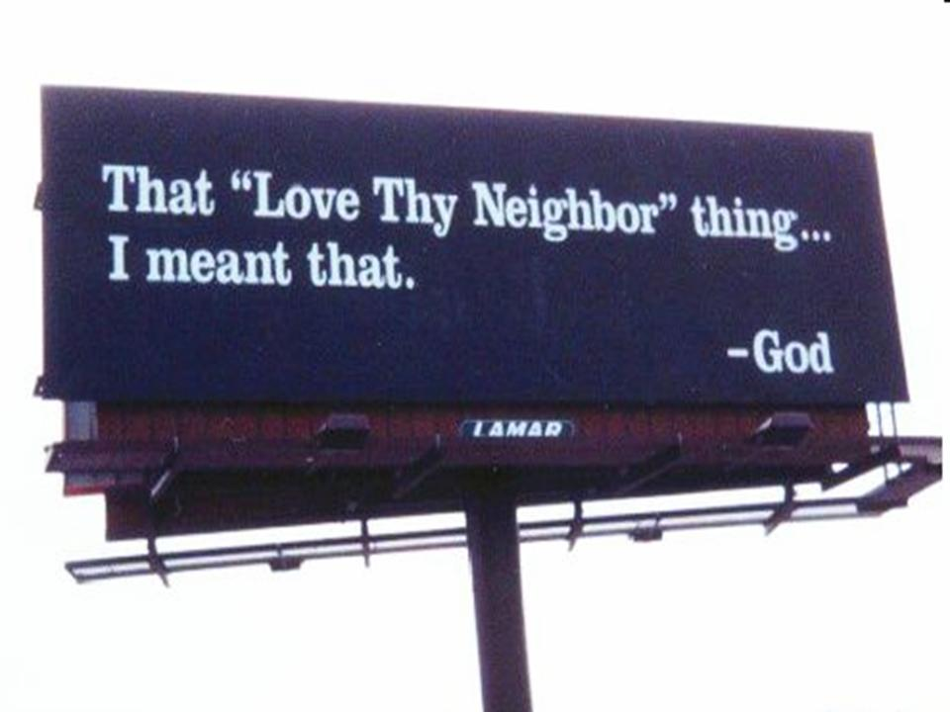
What Good is the Law? 1. Reveals
7:7 What shall we say then? Is the Law sin? Far from it! On the contrary, I would not have come to know sin except through the Law; for I would not have known about coveting if the Law had not said, “You shall not covet.”
Any wild guesses why Paul picked coveting as his example?
Notes:
Interesting to note the wisdom of Paul to choose the 10th commandment to illustrate his point.
Differs from the other nine in that it is an inward attitude not an outward action.
Insidious sin that most people never see but God’s law reveals it to our hearts.
Sin of the rich young ruler Mark 10:17-27. Young man, outwardly very moral but never had faced the sin in his heart. True, never committed adultery, robbed, never given false witness, or dishonored parents, but what about covetousness?
When Jesus told him to sell his goods, and give to the poor, follow Him, he went away, in great sorrow.
Why? Most likely very attached to his possessions, in heart he coveted his stuff.
The commandment “Thou shalt not covet” revealed his sin.
The law is there to point out the things in our life that need to change.
Notice here something has changed.
For an inclusion exercise where many were included “For those who know the law” V1

Slide 9
Is the Law the problem or is it sin?
Timeline understanding:
When was Paul once alive apart from the Law?
When did Paul die?
At birth.
At the presentation of the Law
At the encounter with Jesus on the road to Damascus
When He saw what the law was doing to him.
In Rome
Notes:
Verse nine. I was alive with the law once.
Paul was not always a Christian
Paul did not always have the law
When the law came he became a student of the Law
When the law became the most important thing. He became a COP, Judge and Jury
He saw no joy in his work
He had no peace it it
He could not understand the spiritual in the middle of the law.
Evil desires to do more to justify himself… push him
The law motivated him to be the law manifested to everyone
There was no place, no allowance for hope or mercy or compassion
The desire to justify himself led to nowhere but vengeance
Judgement our of personal guilt. THOSE WHO POINT THE FALLING OF OTHERS ARE THE LEAST TO SEE THEMSELVES.
I Pauil was jew by birth, without the law. The law was not known to me. I could live free and unburdened.
But when the commandment came
When I became aware of the straight line I realized how crooked I had become
It came and I realized I was going to die.
EXAMPLE
Garden of eden…
When did the serpent tempt?
Only after God told them they should not.
Before the law… SIN did not have any power over me.
BUT… when the law came. I DIED.
Before the law came
When was this in Paul’s life?
I had freedom from an accusing conscience, false peace, law changed that.
The happy go lucky days of living without the law, Paul described as life.
Life without the bonds of authority,
Life without the haunting and nagging of expectations to follow along like everyone else.
THEN THE LAW CAME.
THE LAW WAS DESIGNED TO BRING LIFE
THE LAW WAS CREATED AND GIVEN BY GOD TO THE NATION OF ISRAEL AS A BLESSING BECAME DEATH

Slide 10
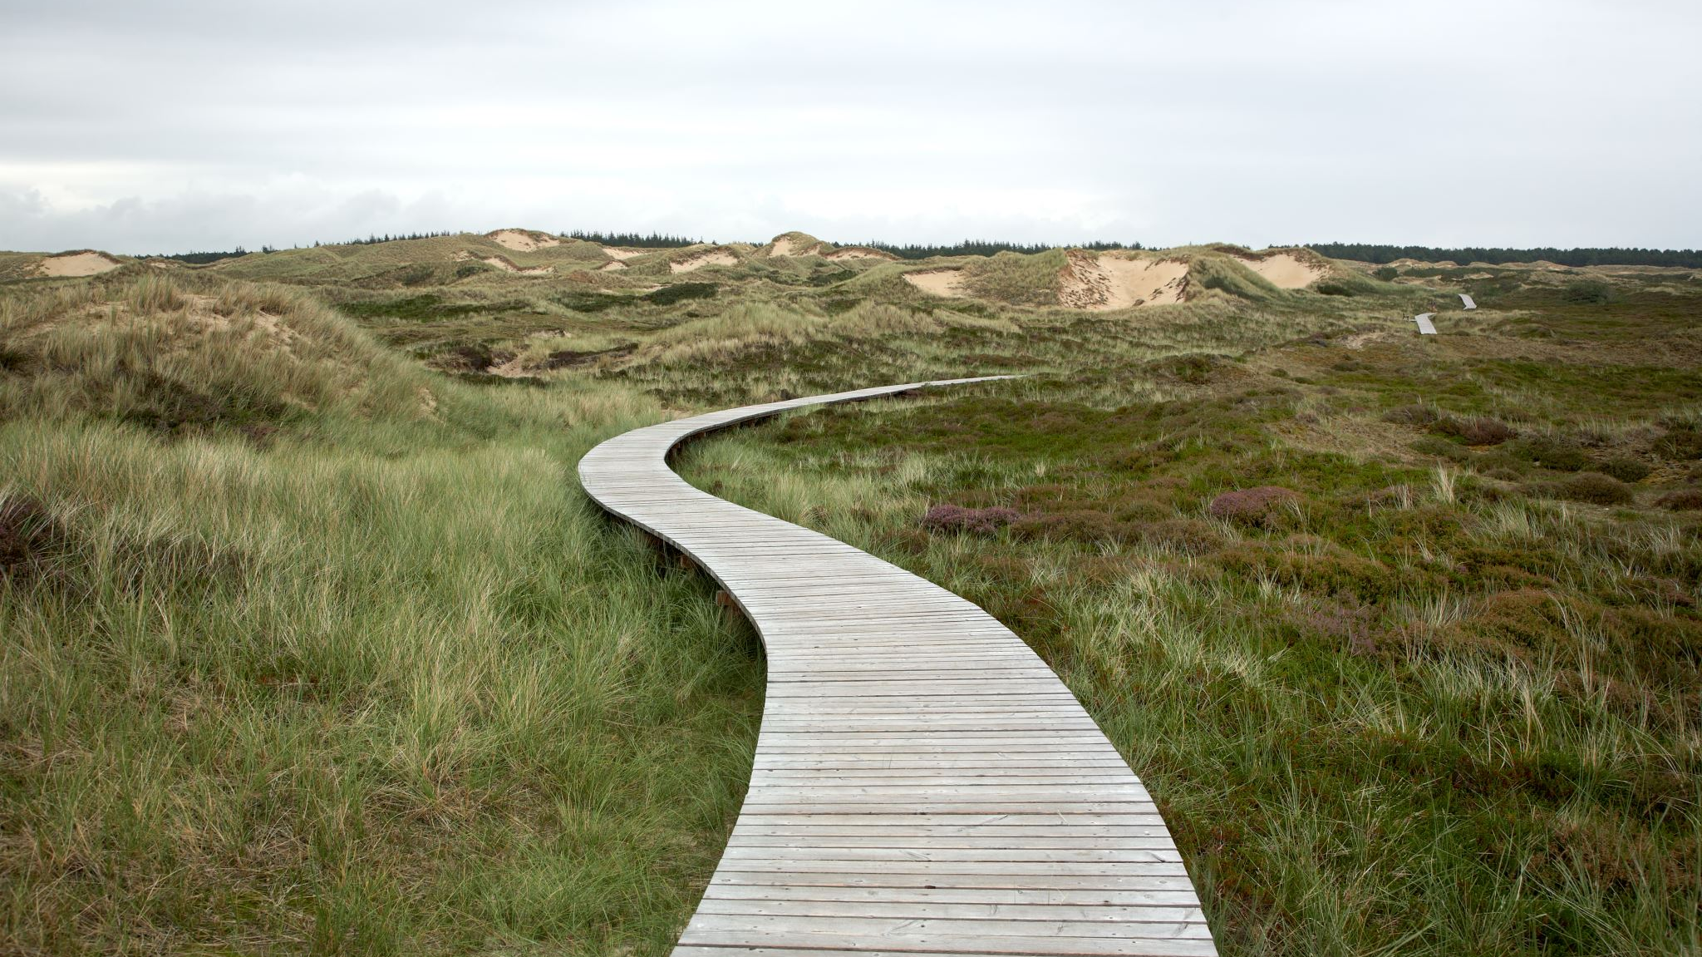
What Good is the Law? Rejection
Romans 7:8,9 But sin, taking opportunity through the commandment, produced in me coveting of every kind; for apart from the Law sin is dead. I was once alive apart from the Law; but when the commandment came, sin became alive, and I died;
Notes:
Showed me there is something in my human nature that wants to rebel whenever a law is given.
The very law that was to bring life instead……FOR PAUL…. Brought death….
Rejection of life

Slide 11
What Good is the Law? Results
7:10. and this commandment, which was to result in life, proved to result in death for me;
7:11. for sin, taking an opportunity through the commandment, deceived me and through it killed me.
What results when we are confronted by the law?
Notes:
What results when we are confronted by the law?
For Paul the Zealot, Pharasee. Bitter hater of Rome and Executioner of Heiritic Christians
The more he learned the worse he felt.
It lured me with a promise
A promise of holiness and life and hope and peace. But in the Law there was none of that.
It just cut him to ribbons
It killed his spirit
And then dragged his emaciated and torn body into anquish.
I slew me
It killed me
It made me miserable.
Law cannot give life, it can only show a person that they are guilty and condemned
Not by the commandment but by sin.
Romans 7:11. Sin deceived me=that’s sin’s greatest power it deceives us.
We’re fooled into thinking we have life under control, when in fact it’s sin that controls us.
Three ways sin deceives:
1. find satisfaction. No one ever took/did something forbidden w/out thinking this will make me happy, then to find that misery followed behind. 2. Excuse our sins. When sin deceives someone, endless excuses and defenses for doing the wrong thing - the one that tears my heart out is when someone says, “well God wants me to be happy, right?” as the justification for sin. Reality is God is more interested in our holiness than our happiness. You can’t use God as an excuse for sin.
3. Believe we will escape the consequences of sin. No one sins without the hope of getting away with it. Numbers 32:23 - Be sure your sins will find you out. Maybe not immediately, but eventually.

Slide 12
What good is the Law? Righteousness
12 So then, the Law is holy, and the commandment is holy and righteous and good.
Notes:
Righteousness
?????What value is there to law if it causes death?
Truth: The Law of God is righteous, revealing our sin, desperate need for God’s grace to help change us.
Application: As you have studied Romans, has God revealed a sin in your life that you need to confess and put away? Has God’s Word pointed out something that makes you feel unsettled, not right? Maybe it’s the first time you really see half-truths as really whole lies? Your critical spirit is really just sin. Offering help is really Manipulation: taking control where God says hands off, let me. I don’t know your sin, we’ve all got areas God is working on in us, what have you seen that needs God’s grace and forgiveness. Process of maturing, growing up in faith = seeing sin, confessing, asking for God’s help. We are never going to be sinless, but the time between seeing our sin and our confession hopefully gets shorter because we are listening to the Holy Spirit convict us, learning what God’s word says is sin, deliberating asking Him to help remove it from our lives.

